Slide 1
Name : BHARANIDHARAN. R Reg No : 410121104009 Department : Computer Science Engineering College Name : Adhi College of Engineering and Technology
Final Project

Slide 2
PROJECT TITLE
Image Classification using CNN
The CNN (Convolutional Neural Network) algorithm is a type of deep learning model designed for processing and classifying images. It consists of multiple layers, including convolutional layers that extract features from input images, pooling layers that reduce spatial dimensions, and fully connected layers that make predictions based on the extracted features. CNNs are widely used in image recognition tasks due to their ability to learn hierarchical representations directly from pixel data.

Slide 3


AGENDA
**Data Acquisition and Preprocessing**: - Downloading a dataset containing images of various fruits from a specified URL. - Extracting the dataset from the downloaded archive file. - Organizing the dataset into appropriate directories.
**Exploratory Data Analysis (EDA)**: - Analyzing the dataset to identify the most frequent fruits. - Visualizing the 15 most abundant fruits and their occurrences using bar plots and sample images.
**Deep Learning Model Implementation**: - Defining a Convolutional Neural Network (CNN) model using Keras. - Compiling the model with appropriate loss function, optimizer, and metrics. - Displaying a summary of the model architecture.
3/21/2024 Annual Review

Slide 4

PROBLEM STATEMENT
**Problem Statement**: Fruit Image Classification using Deep Learning **Objective**: Develop a CNN model to accurately classify images of fruits into their respective categories.

Slide 5

PROJECT OVERVIEW
**Objective:** Develop a deep learning model to classify images of fruits into their respective categories. **Key Steps:** 1. **Data Preparation:** Download, preprocess, and organize the fruit image dataset. 2. **Exploratory Data Analysis (EDA):** Analyze dataset characteristics and visualize sample images. 3. **Model Development:** Build a CNN model architecture for fruit classification. 4. **Model Training:** Train the CNN model on the dataset, optimizing for accuracy. 5. **Model Evaluation:** Assess the model’s performance on a separate test dataset. 6. **Results Visualization:** Visualize model predictions and performance metrics. **Outcome:** A trained CNN model capable of accurately classifying fruit images, with insights into model performance and potential applications.

Slide 6
WHO ARE THE END USERS?
The end users of the fruit image classification model include farmers, food processing companies, retailers, consumers, and researchers.

Slide 7

YOUR SOLUTION AND ITS VALUE PROPOSITION
The fruit image classification model provides an automated solution for accurately categorizing fruit images, offering efficiency, accuracy, cost-effectiveness, quality control, data insights, and enhanced user experience.

Slide 8

THE WOW IN YOUR SOLUTION
The wow factor in the solution lies in its ability to revolutionize fruit classification by leveraging advanced deep learning techniques. By providing an automated, accurate, and efficient way to categorize fruit images, the solution streamlines operations, reduces costs, ensures quality control, and unlocks valuable insights. This not only saves time and resources but also enhances overall productivity and decision-making across various sectors, ultimately transforming how fruits are sorted and managed.
3/21/2024 Annual Review
8

Slide 9
MODELLING
The modeling phase involves designing and configuring a Convolutional Neural Network (CNN) architecture using Keras, with convolutional layers, pooling layers, fully connected layers, and appropriate activation functions, optimized for image classification tasks.
9

Slide 10
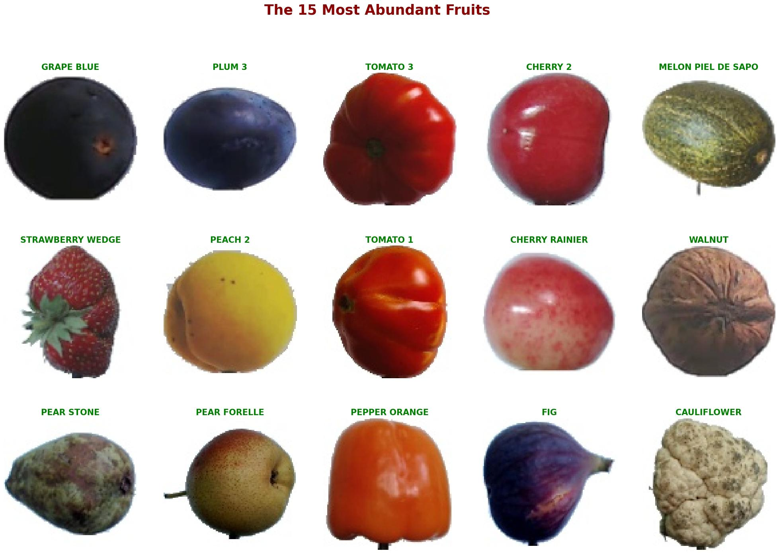
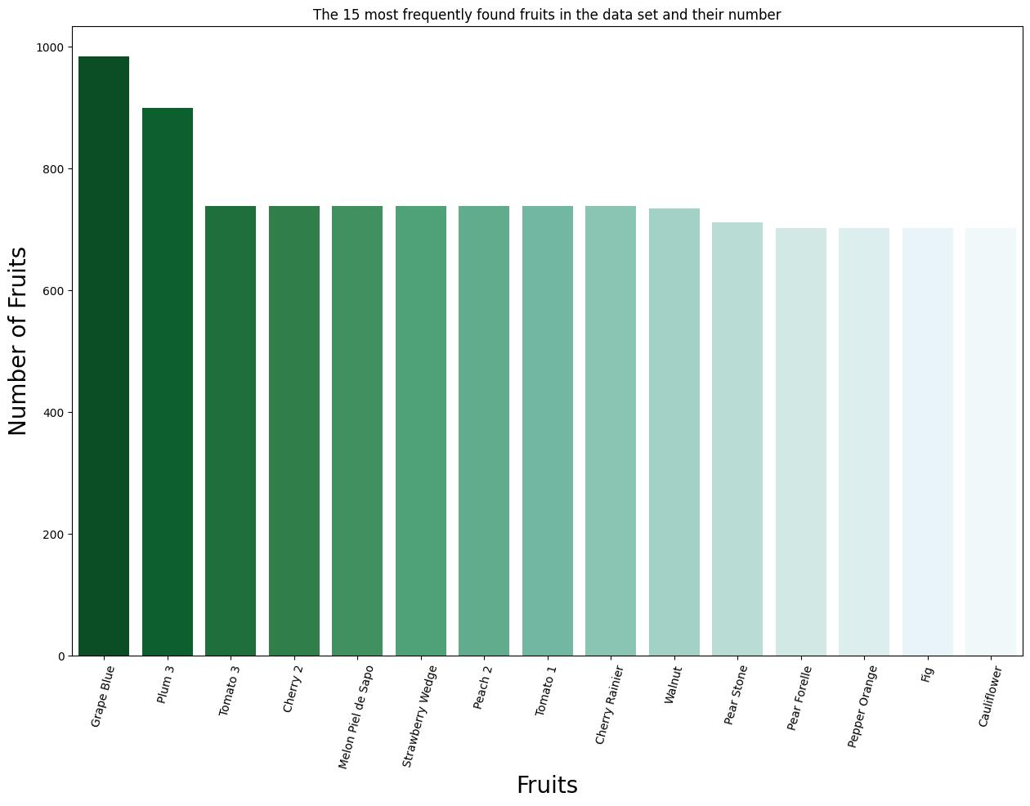
RESULTS
10

